Slide 1



Software
Work experience:
Quality Assurance Engineer at ESI Group [slide 2]
Projects
Calculator Windows desktop app using Qt [slide 3]
‘Tower of Hanoi’ problem on C++ [slide 4]
Control system simulations [slide 5 - 6]
https://github.com/hhcr7
https://www.linkedin.com/in/himanshuhegde/
https://hhcr7.github.io/website/
HIMANSHU HEGDE

Slide 2
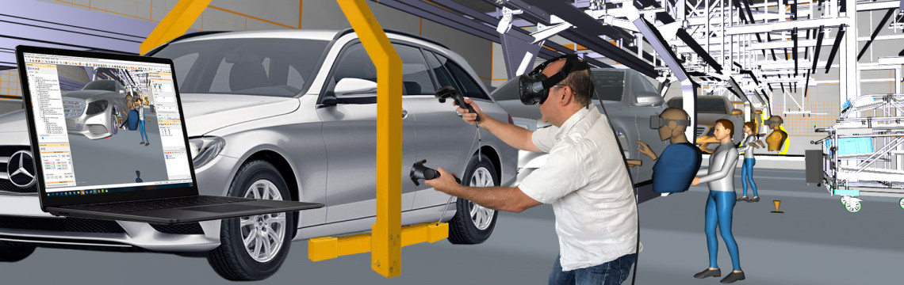
Quality Assurance Engineer at ESI Group
• Worked on the Virtual Reality based physics simulation software ‘IC.IDO’.
• Tested IC.IDO software’s desktop interface and the HTC Vive VR environment, for bugs, workflows and usability.
• Tested usability, created workflows for customers.
• Automation of test cases for the software on the desktop.
• Certified in ‘Foundation Level Software Testing’ by ISTQB.
https://www.esi-group.com/products/virtual-reality

Slide 3
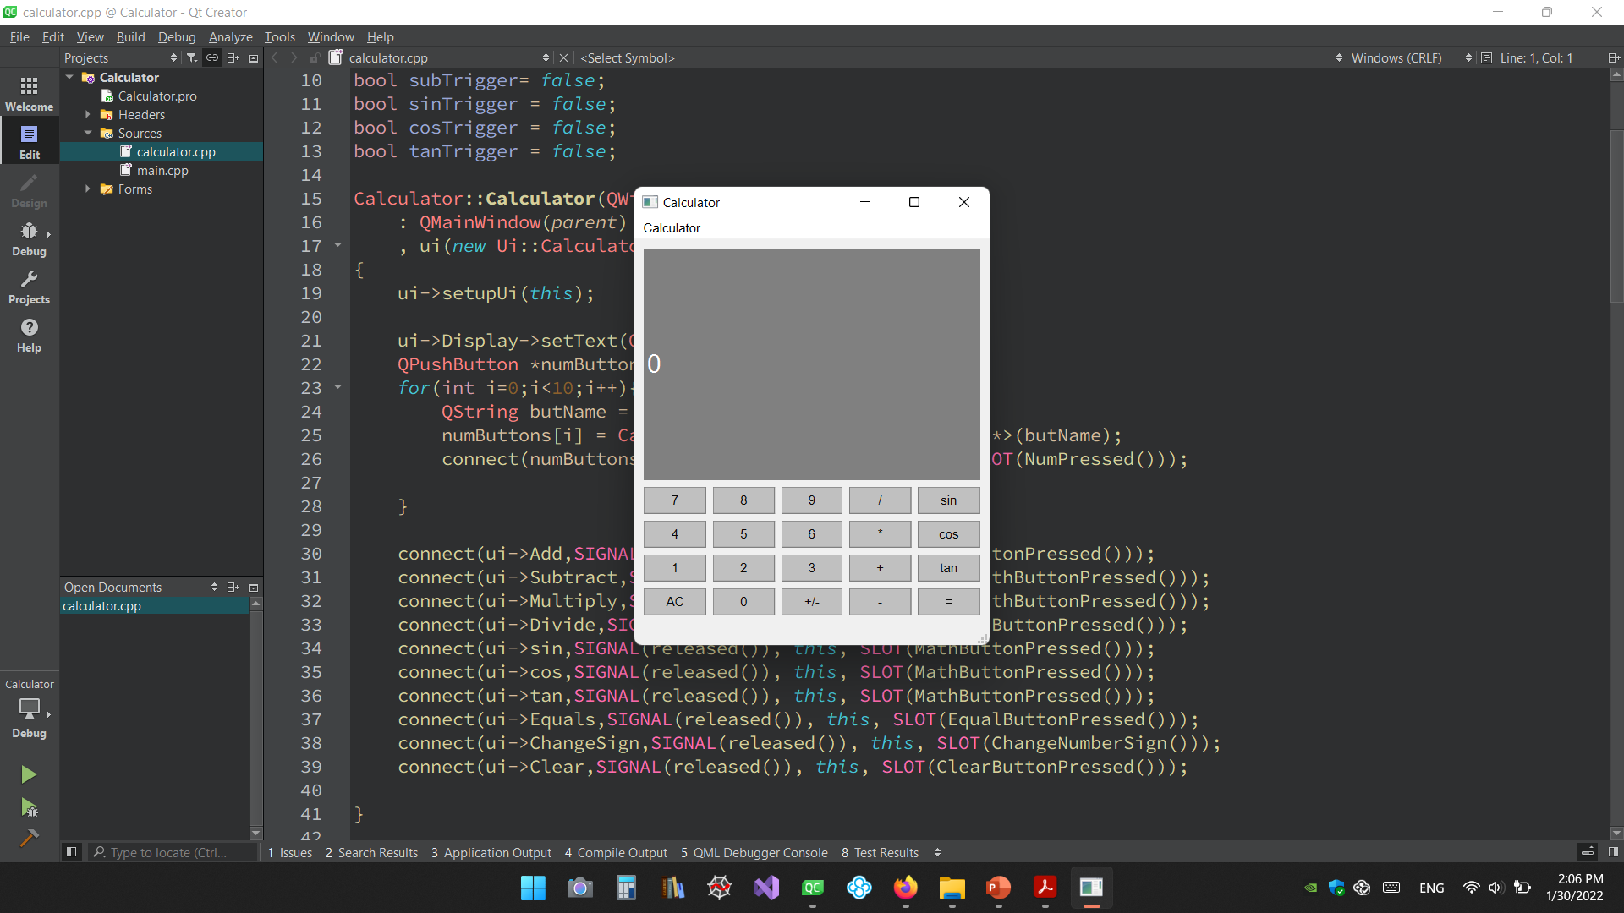
Calculator windows application using qt
GitHub repository - https://github.com/hhcr7/CalculatorApp

Slide 4
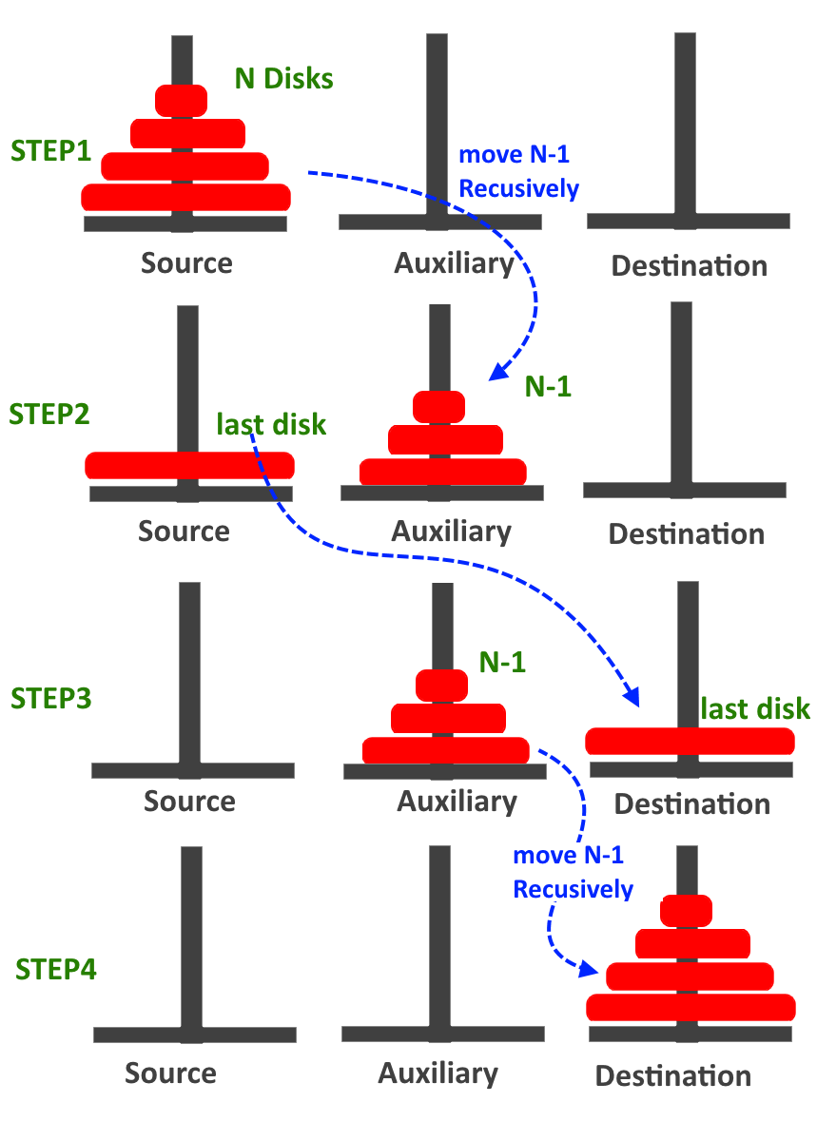
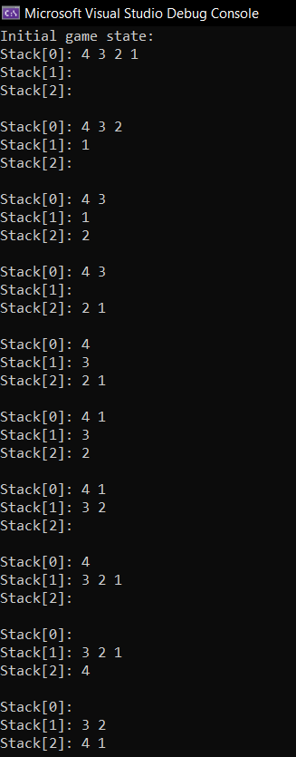
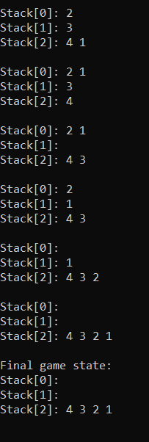
‘Tower of Hanoi’ problem on c++
Algorithm
Solution on console
GitHub repository - https://github.com/hhcr7/TowerOfHanoi

Slide 5
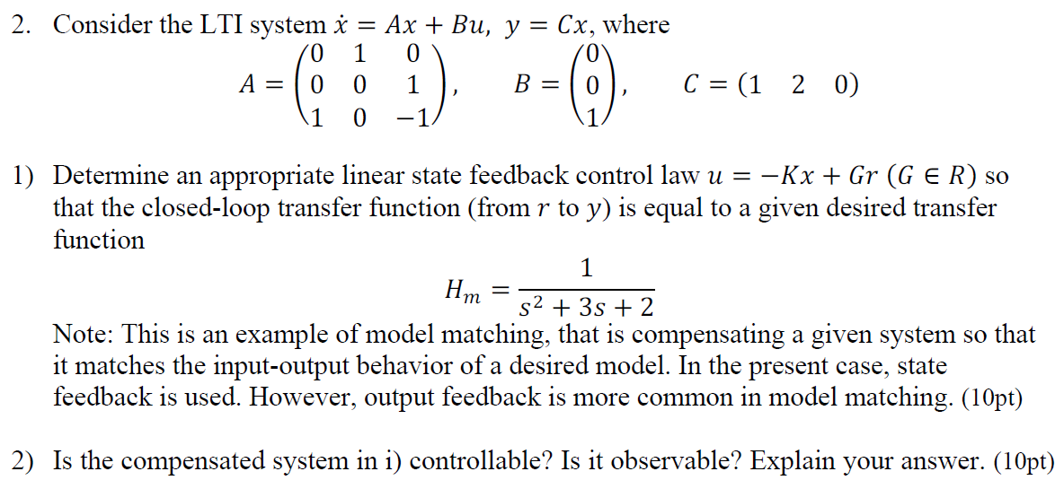
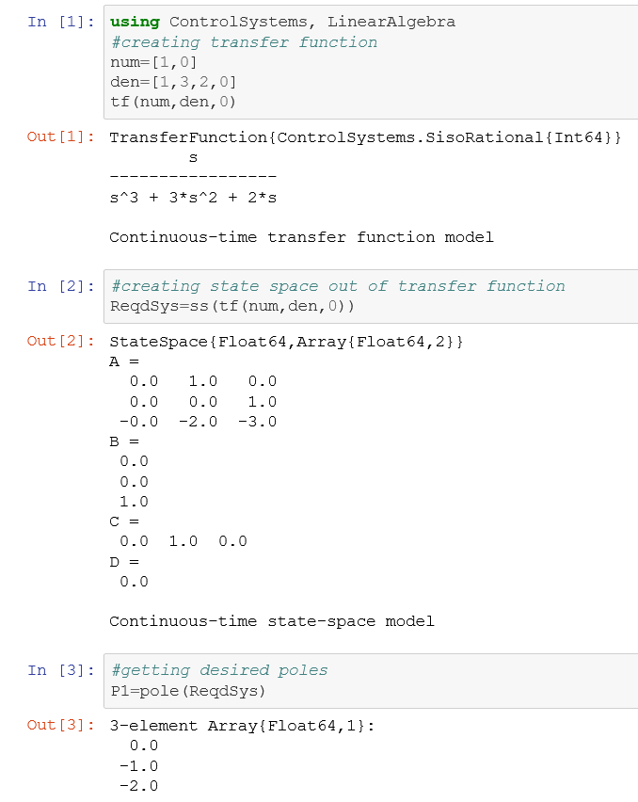
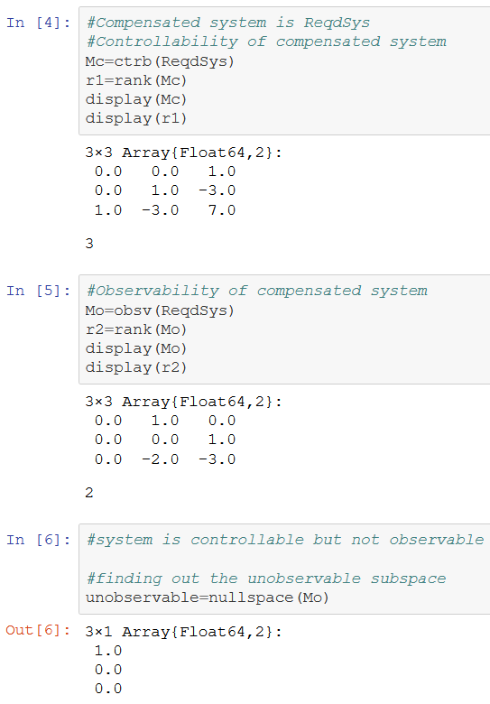
CONTROL SYSTEM SIMULATIONS
TASKS
Solution on Julia
GitHub: https://github.com/hhcr7/ControlSystemDesign

Slide 6
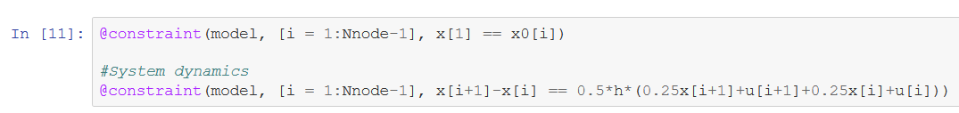
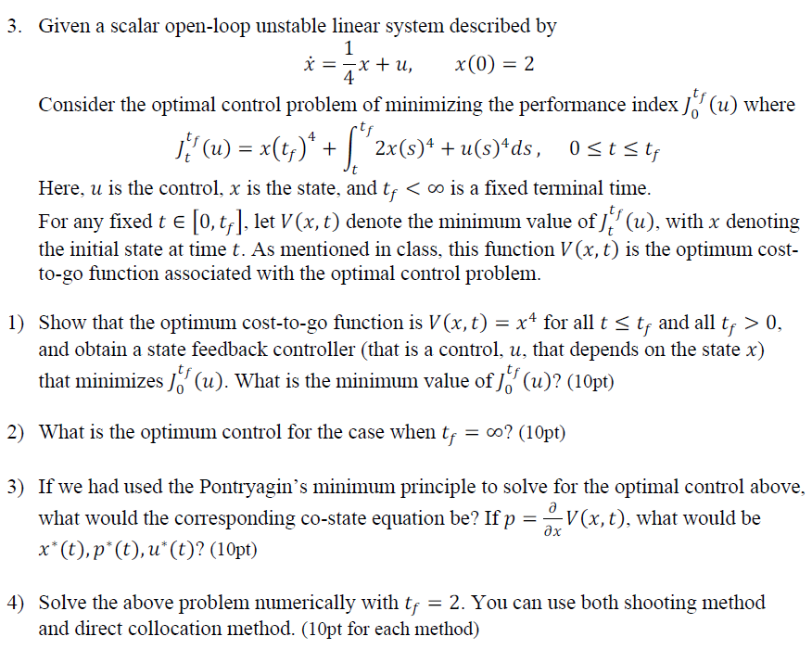
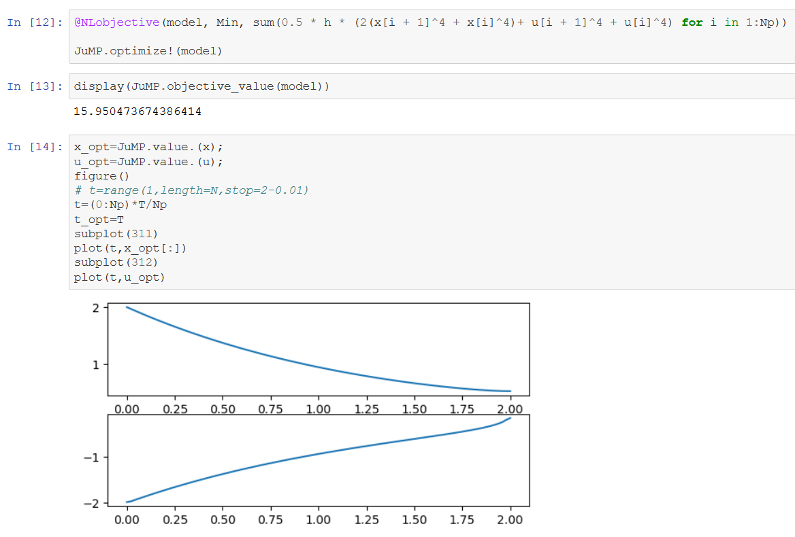
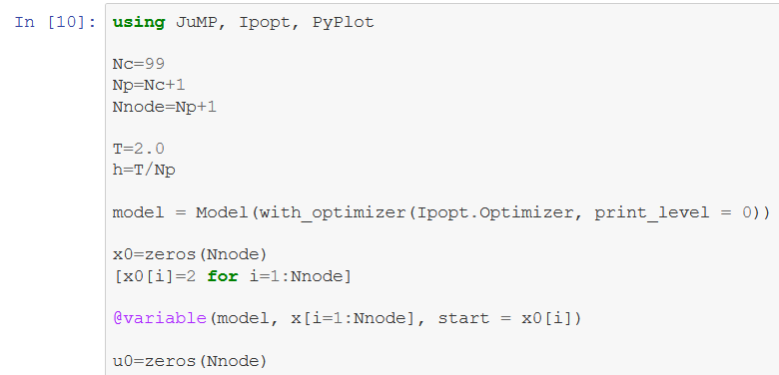
TASKS
Solution to 3.4: on Julia
GitHub: https://github.com/hhcr7/ControlSystemDesign

